Slide 1
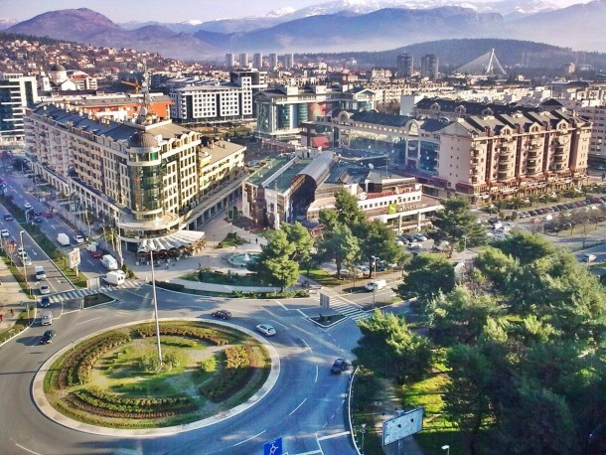
The Future of Compliance in Montenegro
Managing risks in a changing regulatory environment
21 June 2018
Montenegro Banking Association Headquarters
Podgorica, Montenegro

Slide 2
Agenda
09:45 | Registration
10:00 | Welcome & introduction Central Bank of Montenegro or Agency AML Montenegro
10:10 | Changing compliance landscape & the need for automation AML Officer, TBC
10:30 | Raising the bar for compliance in Montenegro Accuity’s de-risking research overview Perspectives, trends & specific findings for Central Eastern Europe The 4th EU AML Directive and future requirements How new technology solutions & AML screening automation can help address challenges Carlos Trinanes, Director EMEA| Accuity
11:10 | Live Polling Questions & Discussion Around best practices in implementing a comprehensive compliance programme You will need your phone to answer the live polling questions
11:30 | Further Networking & Conclusion
The Future of Compliance in Montenegro | 21 June, 2018
Montenegro Banking Association Headquarters | Podgorica

Slide 3
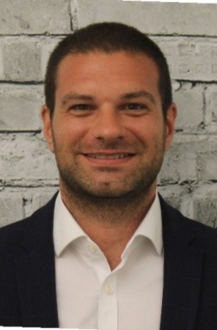
Speakers
.
Hedija Heda Redžepagić,
Central Bank of Montenegro
XXXX is a
Carlos Tinanes
Director EMEA, Accuity
Carlos has spent the last 8 years working for Accuity and is responsible for sales & operations across Europe, Middle East & Africa. With a principal focus on Compliance, KYC and Payments efficiency, Carlos works with leading global Financial Institutions and large corporations across EMEA to manage and mitigate risk, explore enhanced processes and streamline business operations to maximum effect.
TBC
AML Officer
XXXX is a
The Future of Compliance in Montenegro | 21 June, 2018
Montenegro Banking Association Headquarters | Podgorica

Slide 4

Accuity Montenegro Contact
Anna Paluch
Email: anna.paluch@accuity.com
Phone: T M +44 7881 918 688

